Slide 1
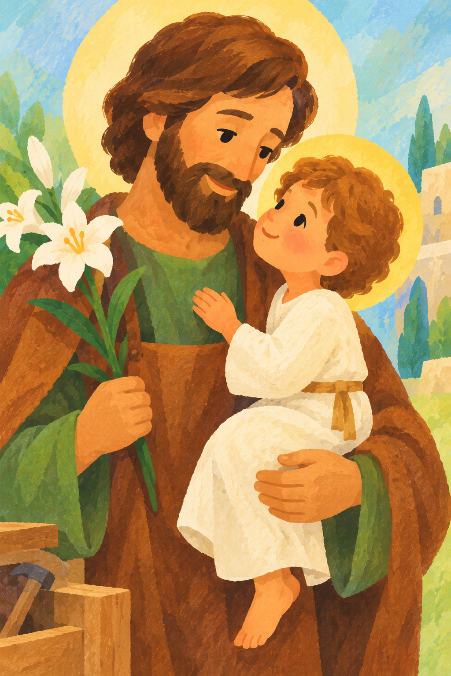
Catholic Life
at
St Joseph’s

Slide 2

St Joseph’s, where we’re
Learning with Jesus, to be the best we can be and we
‘Love, Care, Share’

Slide 3
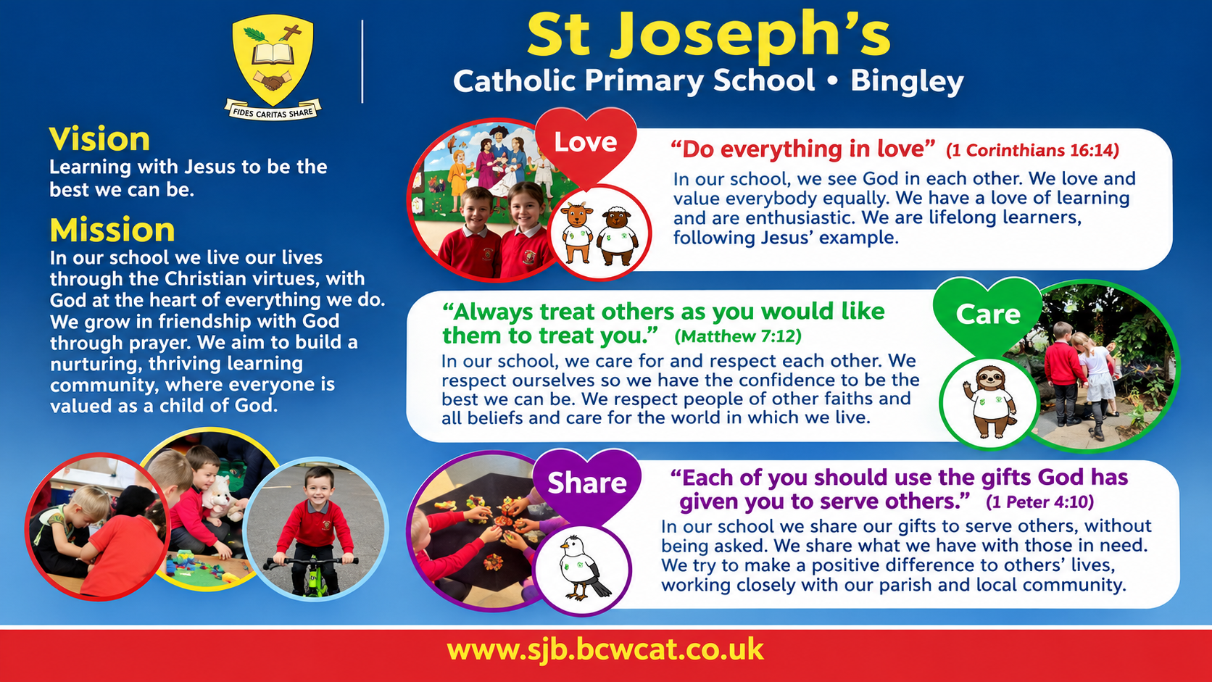

Slide 4




Catholic Social Teaching
Catholic Social Teaching (CST) is rooted in Scripture and the teachings of the Church. It encourages us to follow Jesus’ example by promoting love, justice, peace and respect for all. We are called to care for one another, protect God’s creation and work towards the common good.
At St Joseph’s, Catholic Social Teaching is woven throughout our curriculum, worship and daily school life. Children learn to put their faith into action, recognising how their choices can make a positive difference to others and the world around them. We use CAFOD resources and animal mascots to help children understand and live out these principles. These four are particularly linked to our school mission of ‘Love, Care, Share’:
LOVE
Human Dignity – Everyone is Special
Solidarity – We Are One Global Family
CARE
Stewardship –
Caring for God's Creation
SHARE
Preferential Option for the Poor –
Putting Those Most in Need First

Slide 5
Pupil Leadership – Love, Care, Share
Our pupil leaders play an important role in our Catholic life and help us to live out our school motto: Love, Care, Share.
        Faith Leaders – Love: Our Faith Leaders help to lead and prepare Celebrations of the Word. They help our school to focus on solidarity and human dignity, encouraging us to love and respect everyone.
        Laudato Si' Leaders – Care: Our Laudato Si' Leaders show stewardship by caring for God's creation. They litter pick, promote recycling and encourage everyone to look after our school environment.
        Mini Vinnies – Share: Our Mini Vinnies live out the preferential option for the poor by supporting people in need, fundraising and helping others in our school, parish and wider community.
Our other pupil leaders also make a positive difference. School Council, Wellbeing Warriors and Sports Leaders listen to others, support their peers and help to make our school a better place.
Together, our pupil leaders help children to see that they can make a difference and put our Catholic values into action through Love, Care and Share.

Slide 6
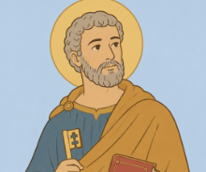
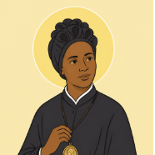
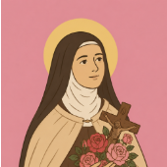
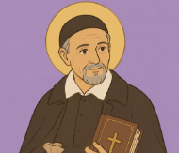
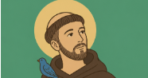
Class Saints
As a Catholic school, we wanted the names of our classes to help us keep our faith at the heart of school life. Our Mini Vinnies, School Council and Faith Leaders worked together to choose which saints would be most suitable for each class.
At the beginning of the school year, each class learns about their new patron saint. Children find out about their saint's life, their faith and the ways in which they followed Jesus and helped others. This gives each class the opportunity to develop a special connection with their saint.
Throughout the year, each class will celebrate their saint's feast day and lead a whole-school Celebration of the Word based on their class saint, sharing what they have learned and helping the whole school community to learn from their saint's example.
Through our class saints, children are developing a growing understanding of how faith can be lived out through prayer, service, love and action.

Slide 7
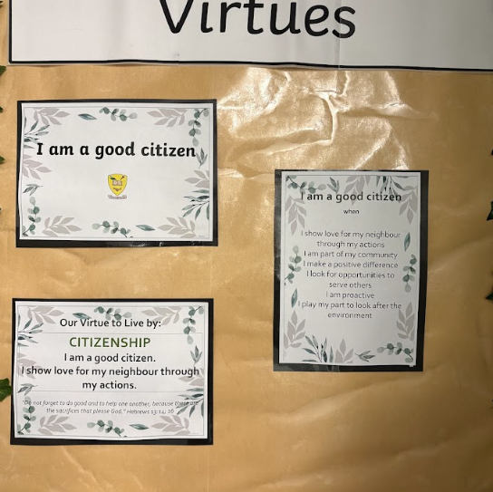
Our Virtues
Our school virtues help children to understand how we can live out our faith through our words and actions.
Each Friday, one child from each class receives a Virtue Award for showing one of our school virtues. These awards are celebrated in class during our weekly Celebration of the Word.
We also have a Virtues Book, where children and staff can nominate others when they see someone showing our virtues in school. This helps us to recognise and celebrate the positive choices and actions of members of our school community.

Slide 8
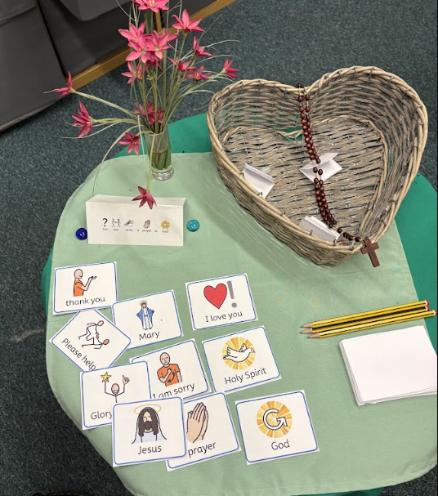
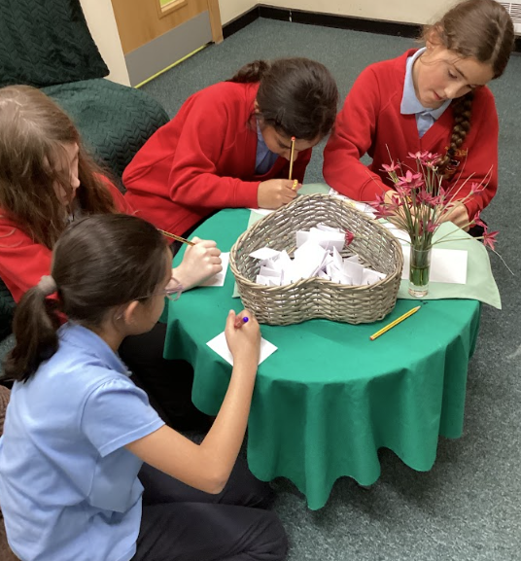
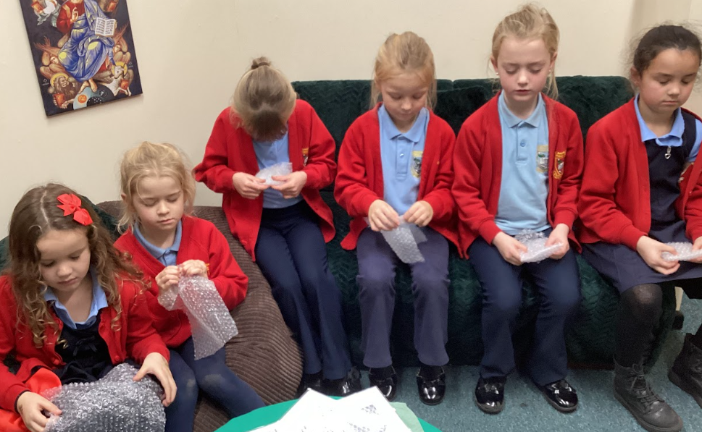
Our Prayer Room
We have a dedicated prayer room in school, providing a quiet space for children to pray, reflect and spend time with God.
As a dedicated Prayer Spaces school, children are given the opportunity to use the prayer room each week. Our Faith Leaders also use the space to pray, reflect and prepare their Celebrations of the Word.
The prayer room is an important part of our school’s prayer life and helps children to develop a personal relationship with God

Slide 9
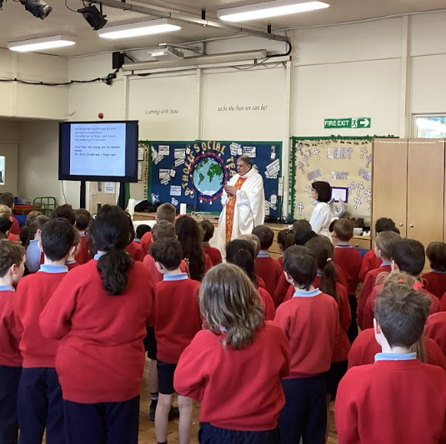
St Joseph's Feast Day Mass
As a school community, we came together to celebrate the feast day of our patron saint, St Joseph. We celebrated Mass together, giving thanks for St Joseph and reflecting on his example of faith, love and care for his family.
The children took part in the Mass through prayers, hymns, readings and responses, helping us to celebrate together as a Catholic school community.

Slide 10
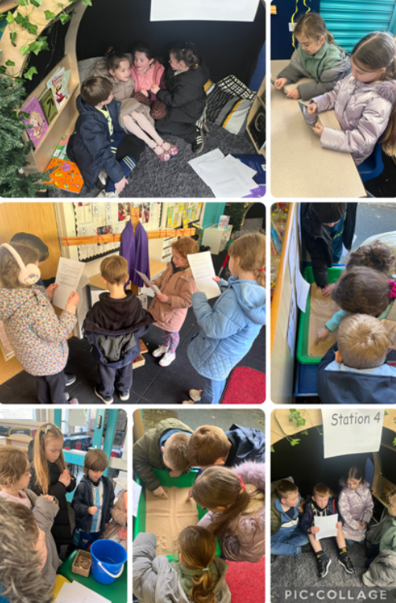
Lent
During Lent, Year 2 had special Lenten prayer stations. The children used the prayer journey during the week as part of their provision, taking time to be still, reflect and pray.
Parents were also invited to use the prayer stations along with their children after school, giving families an opportunity to share a quiet moment of prayer together during Lent.

Slide 11
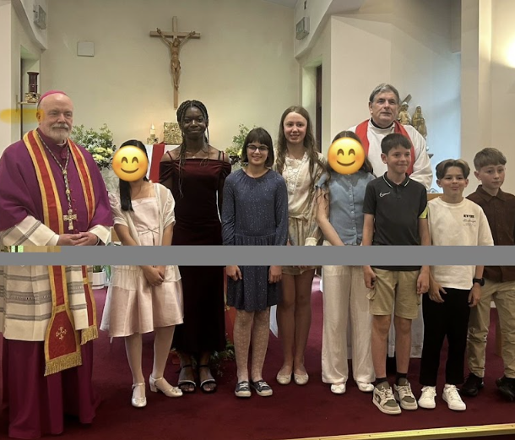
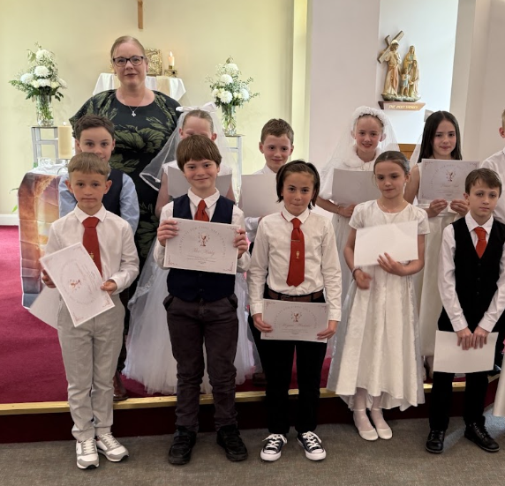
Sacraments
The sacraments are an important part of our Catholic school life. We support and prepare our children as they grow in their faith and take part in the sacramental life of the Church.
Each year, our Year 3 children receive the Sacrament of Reconciliation, with preparation taking place in school. During Lent, all children in Key Stage 2 have the opportunity to go to Confession after Friday Mass.
Our Year 4 children prepare for and receive their First Holy Communion, with their preparation supported by school. Our Year 6 children prepare for and receive the Sacrament of Confirmation.
These special celebrations help our children to deepen their relationship with God and to understand the importance of the sacraments in their lives.

Slide 12
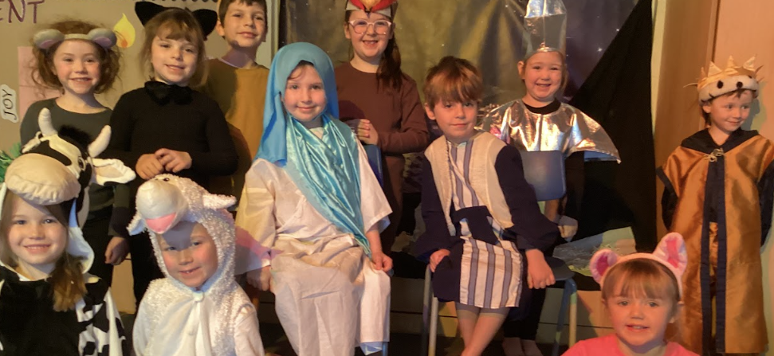
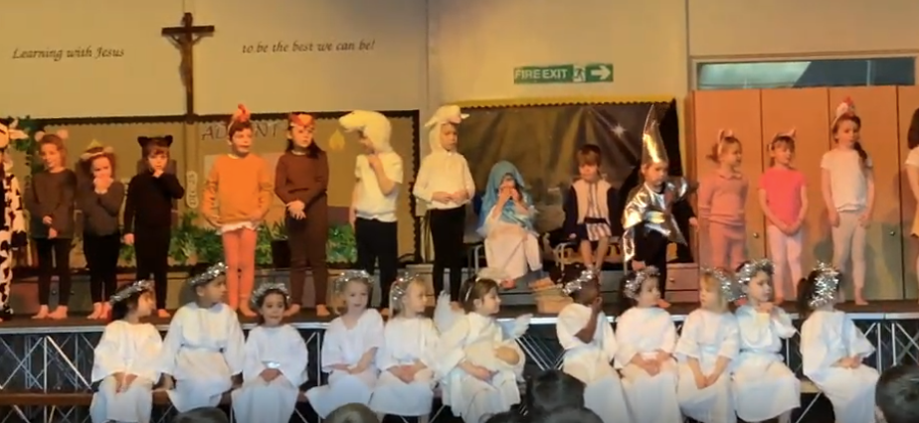
EYFS and Key Stage 1 Nativity
Our EYFS and Key Stage 1 children came together to perform their Nativity for families and the school community.

Slide 13

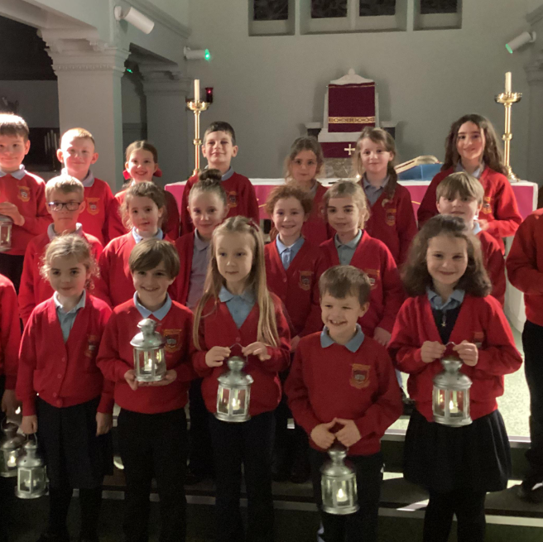
Year 2 Candlelight Carol Service
Our Year 2 children led a candlelight carol service for the whole school community. Through prayers, readings and carols, the children shared the important message of Christmas – the birth of Jesus.
The service gave our school community a special opportunity to come together in prayer and reflection as we prepared to celebrate Christmas.

Slide 14
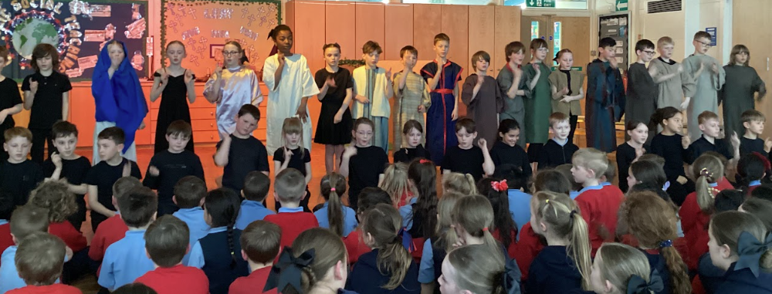
Year 4 and 5 Easter Celebration
Our Year 4 and 5 children prepared a special Easter celebration for members of our school community. Through drama, readings and music, they shared the story of Holy Week and Easter.

Slide 15
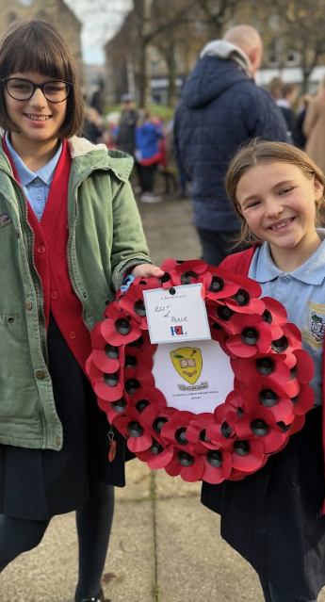
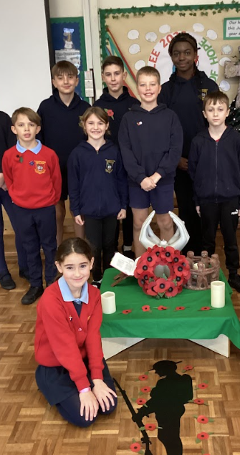
Remembrance
In November, we take time as a whole-school community to remember and reflect. Our Faith Leaders lead a whole-school Celebration of the Word, helping us to pause, pray and think about those who have given their lives in service of others.
Our Faith Leaders also attend the Remembrance Parade in Bingley, joining the local community to pay their respects to those who have served and sacrificed for our freedom. This is a valuable opportunity for the children to show their gratitude, reflect on the importance of peace and honour the memory of those who gave their lives for others.
We also have special prayer activities in our prayer room, giving children the opportunity to pray quietly and reflect on the importance of peace and remembrance.

Slide 16
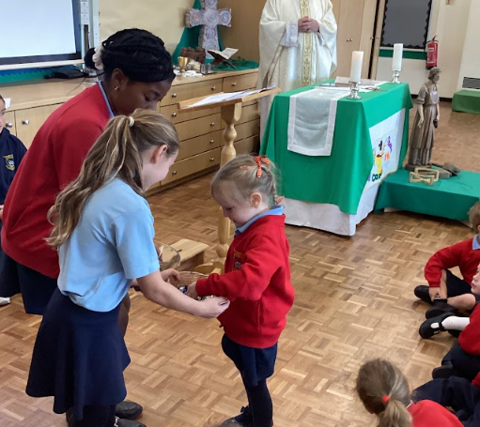
Welcome Mass
At the beginning of the school year, we celebrate our Welcome Mass as a whole school community. It is a special opportunity to welcome our new pupils and staff and to remind everyone that we are part of the St Joseph’s family.
As part of the Mass, each new child and staff member is given a pebble. They add their pebble to our school bowl as a symbol of joining our school family and becoming part of our community.
During the Mass, our priest also anoints each member of staff with oil as a sign of their service and commitment to working in a Catholic school. This reminds us that all staff have an important role in supporting our children and living out our Catholic mission.
When our children leave us in Year 6, they take their pebble with them as a special reminder of their time at our wonderful school and the family they have been part of.
Year 6 and Reception Buddies
Our Year 6 children become buddies with our Reception children when they join our school. This helps our youngest children to feel welcomed, safe and part of our school family.
Throughout the year, the buddies spend time together in a range of activities. They attend Mass together, visit places, complete activities and share special moments.
The buddy system helps our children to develop kindness, friendship, responsibility and care for others.

Slide 17
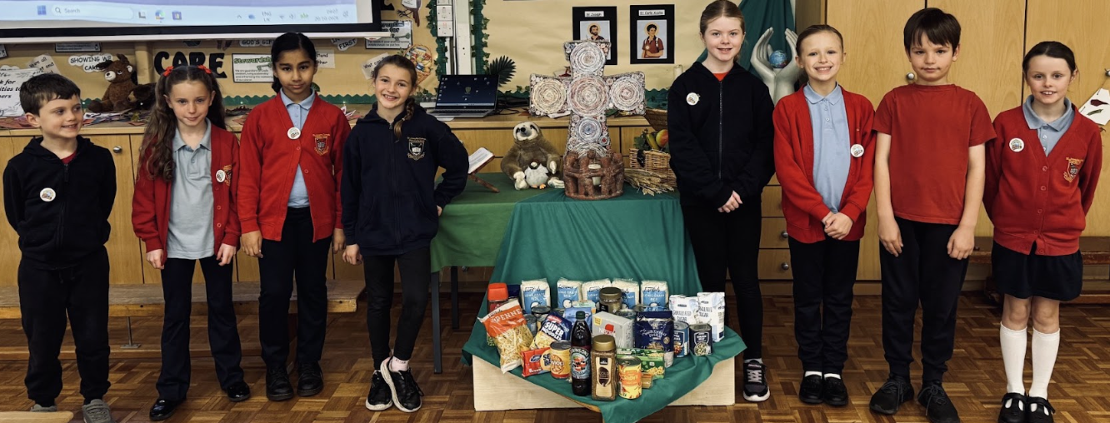
Our Mini Vinnies led our whole school Harvest Liturgy, with Brother Joseph from the Franciscan Friars joining us to celebrate with the children.
Members of the SVP from our parish also attended and supported the children. Together, we gave thanks to God for the food and gifts we receive and reflected on the importance of sharing with and caring for others, especially those in need.
As part of our Harvest celebration, we collect food items from our school community, which are then donated to St Patrick’s Mission in Bradford to support people in need.
Harvest
Liturgy

Slide 18

Supporting Mary's Meals
As a school family, we supported Mary's Meals, a charity that provides meals to children living in some of the world's poorest communities.
Our guest speaker, Vivien Drake, visited school and led an assembly, helping the children to understand how Mary's Meals supports children and the importance of food and education.
The children then took collection boxes home to raise money for the charity. Our parish community also supported Mary's Meals by raising money, showing how our school and parish work together to care for others and put our faith into action.

Slide 19
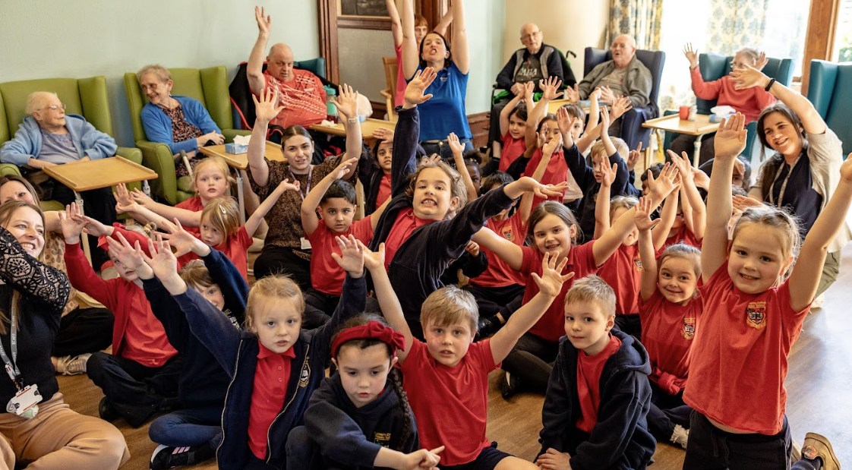
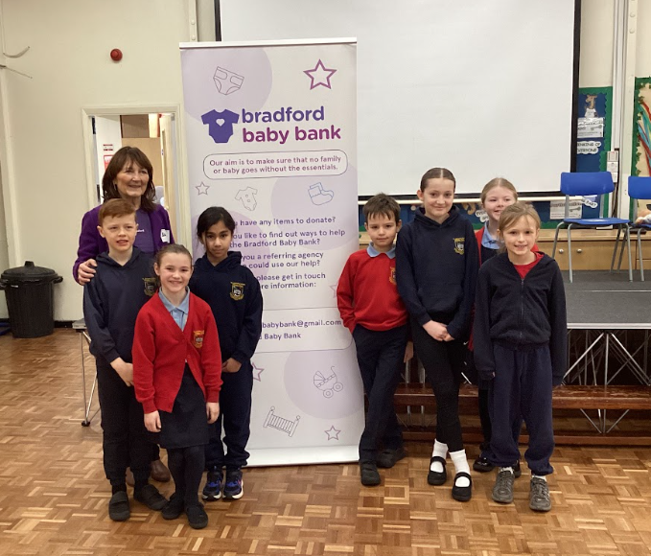
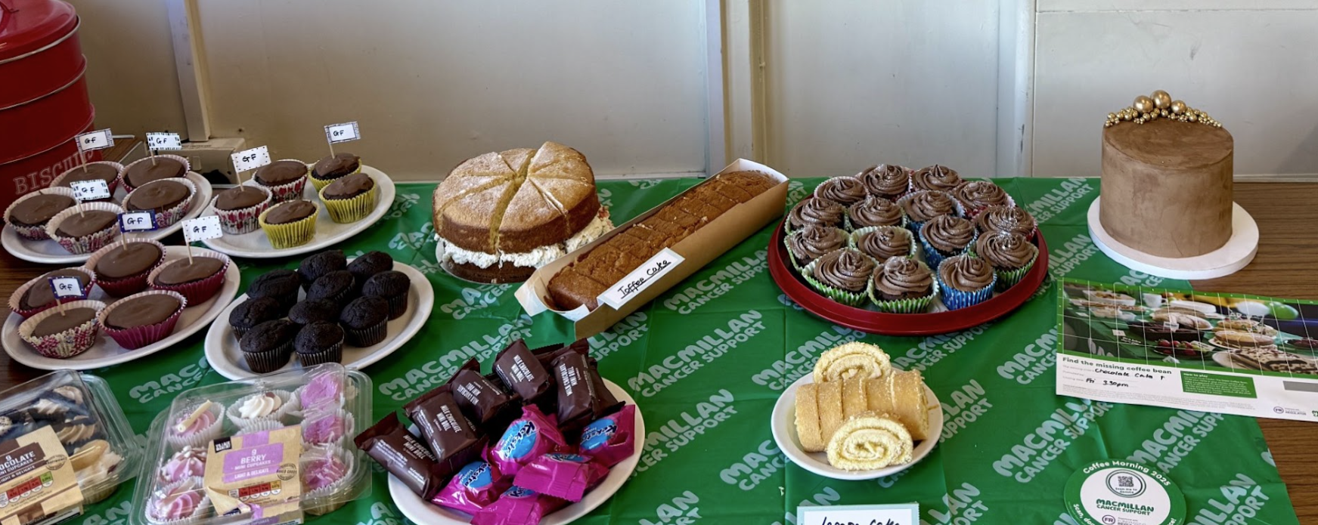
Some of our events to support our mission….
Playing with our ‘grandfriends’, running a MacMillan Coffee Morning, collecting for Bradford Baby Bank

Slide 20
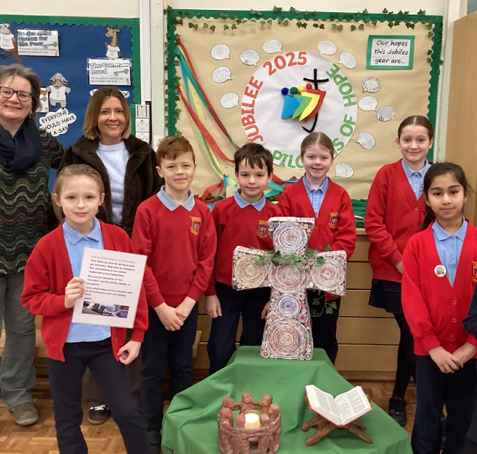
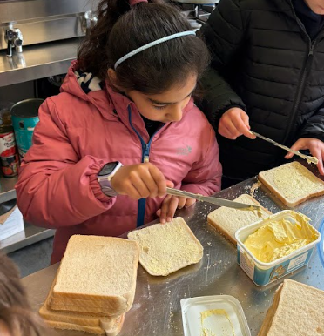
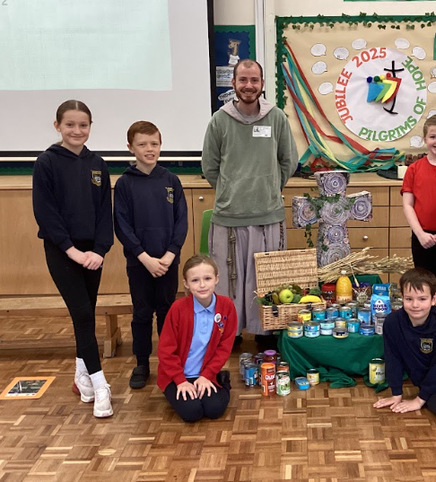
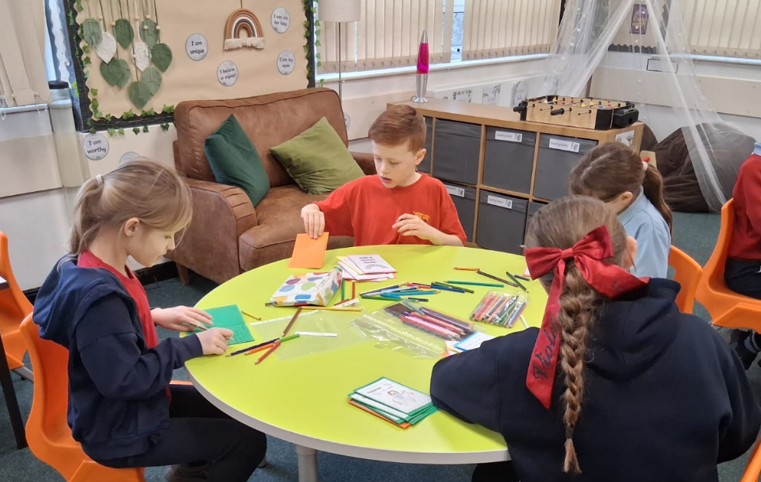
Supporting Inn Churches, St Patrick’s Mission, making cards for our local parish

Slide 21
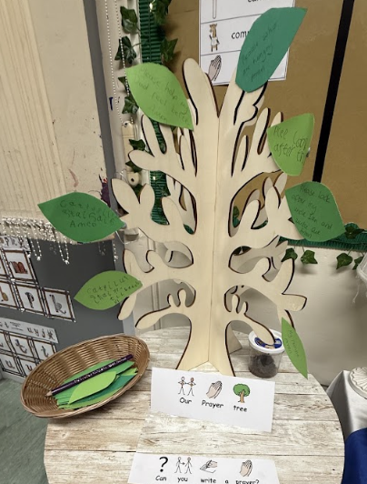
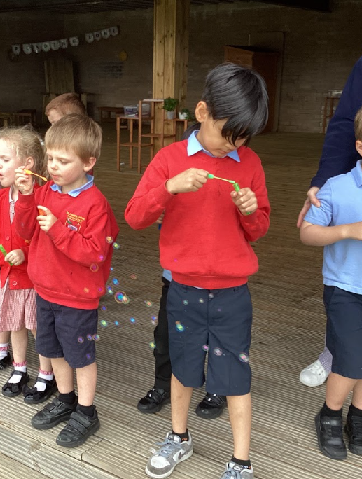
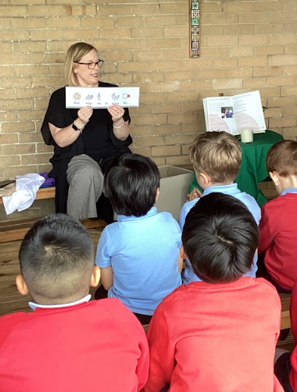
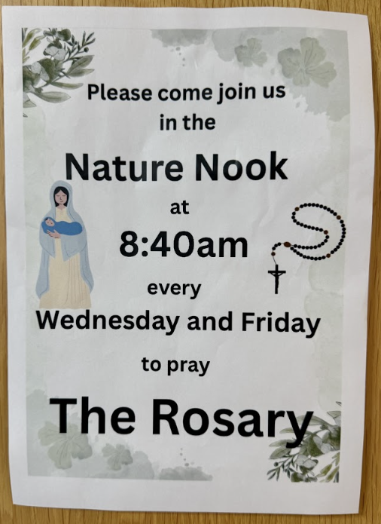
Prayer at St Joseph’s

Slide 22
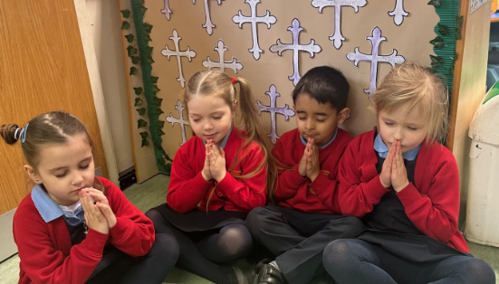
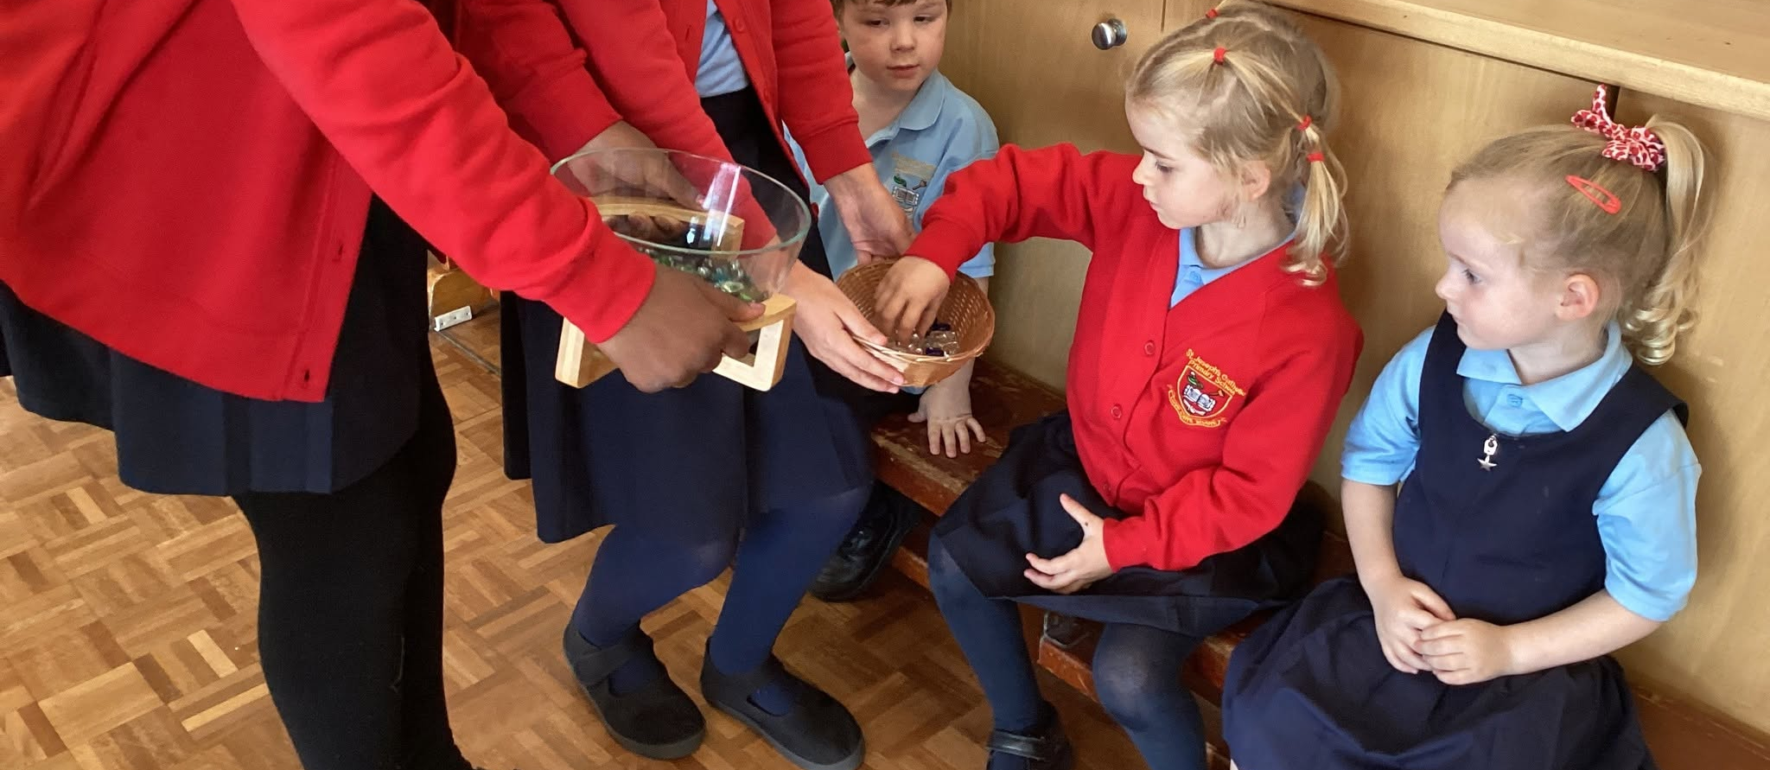
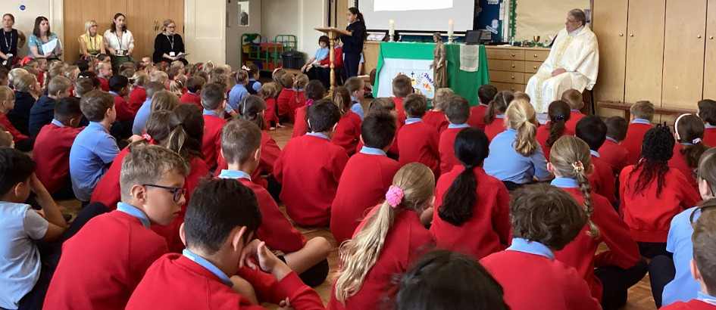
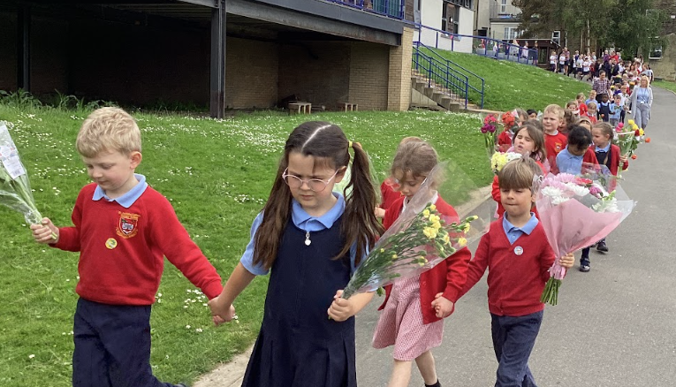

Slide 23
